Slide 1
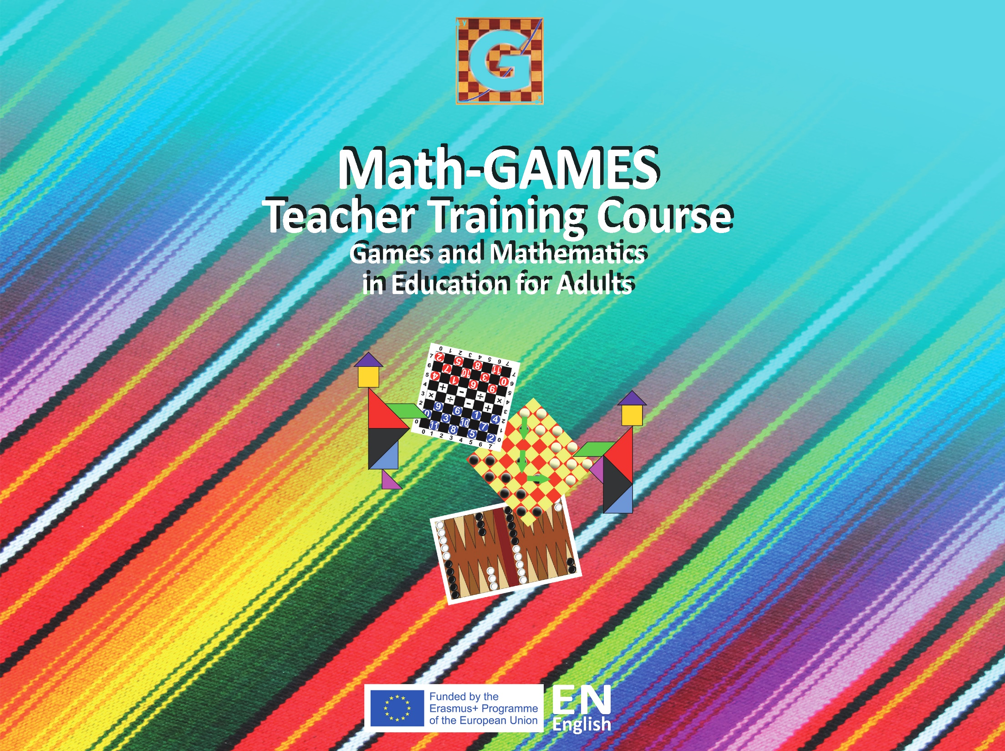

Slide 2
Objectives
Students will
learn about coordinates and learn to find positions on a chess board.
understand the value of game-objects.
learn to multiply by 3.
learn to solve easy equations with symbols.

Slide 3
Tools, materials and organisation
Take a chess board for every 3 players.
Prepare copies of the Worksheets for each student.
The lesson takes 45 to 60 minutes or more.

Slide 4
Description of the lesson
Divide the lesson into three parts
First part : Describe the game and present the coordinates.
Second part : Give each group a chess board and chess pieces. Explain to students the value of each chess piece. Then the students fill in the worksheet exercises.
Third part : Check the students’ answers. Discuss the results and provide explanations.

Slide 5
Useful Hints
More exercises in the Greek language on http://aesop.iep.edu.gr/node/13670
Ask students to play a chess game and note the coordinates for every move they make.

Slide 6
Value of each chess piece
Pawn: value 1
Knight (Horse): value 3
Bishop: value 3
Rook (Castle): value 5
Queen (Lady): value 9
King: value ∞ (infinite)

Slide 7
EXERCISE 1
Knowing that the Knight is worth as much as three Pawns, draw as many Pawns as needed to have equal power with the Knight in the left column.

Slide 8


Methodology
Present to students the equation:
Explain that two knights are equal to six pawns.
because 3+3 =6 or 2x3=6
3. Count and colour six pawns on the worksheet. Continue in the same fashion with the rest of the exercise.
+
=
+

Slide 9
EXERCISE 2
Circle the piece with the higher power in each of the four pictures!

Slide 10
Methodology
Tell students to look at the first picture showing the Rook and the Knight.
Remind students the value of each chess piece, the Rook has a value of 5 and the Knight has a value of 3.
Students can use their fingers to understand the concepts of the numbers 5 and 3. Explain that the Rook has more power than the Knight because 5>3.

Slide 11
Ask students to circle the more powerful chess piece of the two.
Continue in the same fashion with the rest of the exercise.

